Slide 1
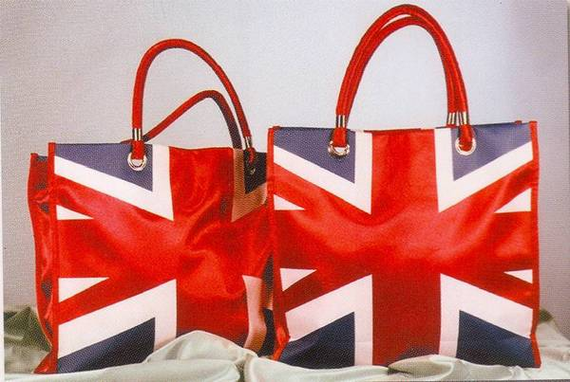
Shopping in Britain

Slide 2
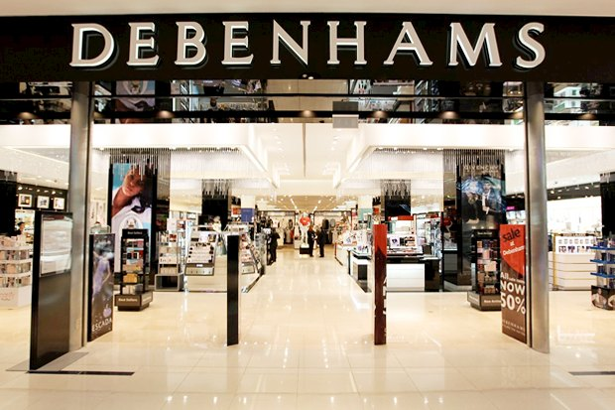
Oxford Street.
Debenhams
Selfriges
Notes:
The center of attraction for all tourists - huge Department stores "Selfridges" (Selfriges and Debenhams" (Debenhams). The first is expensive, the second is more democratic.

Slide 3
Fenwick
John Lewis

Slide 4
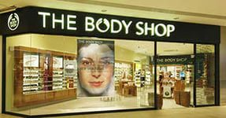
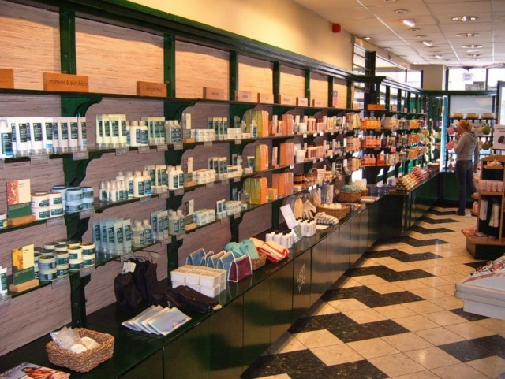
Body Shop
Notes:
the English equivalent of our "For the soul and the soul"

Slide 5
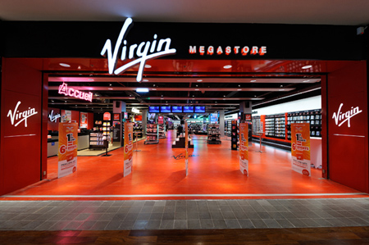
Virgin Megastore
Notes:
a real treasure for music lovers and bibliophiles.

Slide 6
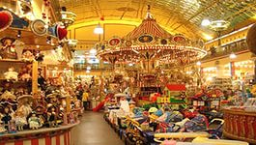
Regent Street.
House of Cashemire
Hammleys
Notes:
In the House of Cashemire - silk pashmina, Hammleys - huge toy Kingdom, which as enchanted roam not only children. The Teddy Bear Company Teddy bears. On Regent street (Regent street), adjacent to Oxford Street (Oxford street), you will also find a wide selection of shops, there is a large Department store Liberty.

Slide 7
Piccadilly
Notes:
Piccadilly (Piccadilly) is a traditional place for shopping, where since ancient times, there was a small English shops. Here you can also visit the Department store Fortnum and Mason.

Slide 8
Soho
Notes:
Even if the time on the London visit is reserved bit in the "SOHO" to be sure. For the sake of great books, music and clothes shops.

Slide 9
Portobello Road
Notes:
More famous flea market does not find all over the world! Come out of the subway and... go to Portobello. This is a real flea market - in all senses of the word! Vintage clothing, accessories, jewelry, vinyl, beads, Antiques, ethnic trophies from all over the world, original remake, leather, military uniform and treasures from grandma's attic. Rates negotiable. You can and should bargain. Often the question: "how Much?" answer: "how Much you give". Be patient and prehispanic desire in whatever was to find something incredible. Then you have the chance to find something unique, such as the Japanese kimono seventy years ago for £ 20. Antiques sell on Saturdays from 8 till 17:00.

Slide 10
TOPSHOP
Notes:
TOPSHOP is the largest Department store in Europe. This four-storey monster put their nets near the metro station Oxford circus. Each floor area the size of a good gym. On the underground level in the clear felling a DJ own "topshadowcolor radio. Range of screens - while standing in line at the cashier, you can see new clips. The streets are always crowded, there are queue - number of those who wish to dress in the most-most. Vast Department of handbags, wigs, belts, watches and jewelry, hats, scarves and tights of different colors on the same floor.

Slide 11
OASIS
Notes:
OASIS - shop for women with big letters. Here's all rounded, soft and flowery. Shoes - so stilettos, dress in roses. Fall classic choices of fashion items, use natural fabrics. The collection is updated weekly. Ladies ladies over 30. Costs: not too expensive, but... In addition to boutiques with clothes in London many shops with original cosmetics, trinkets, neck, hair, fingers, toes, shoes of all shapes and colors.

Slide 12
Useful information about shopping in London
1. The shops in town are open Monday to Saturday from 9:30 to 18:00. Large shopping centers and Central stores up to 20:00. But on Sunday, all without exception close at 17:00. 2. January and July - time sales in all stores England. 3. Look at the stores sign Tax free. This ensures that the tax refund. Tax VAT is 17.5% and is included in the price of the goods. At the airport at customs you will return about 11% of the price of the goods, if you show a receipt for Tax free Shopping. Food, books, alcohol, and tobacco products Tax free does not apply. 4. The Royal Warrant Holders Association - this sign on the front door of the shop means that its owner is an official supplier to the Royal court. For true fans of the Queen of England. 5. Shopping in London will cost 26% more expensive than in new York. According to a study conducted by economists Swiss Bank UBS, European cities are the most expensive in the world. The three leaders named Oslo, London and Copenhagen, and on the fourth place went to Dublin. American cities, on the contrary, take the position because of the weak dollar: new York ranked only 18th place, behind Tokyo and Brussels. 6. www.debenhams.com site of the famous Department store. 7. In London sale traditionally start to the New year (usually 27-28 December) and turn to the real occasion for the citizens and tourists. In the UK its own system sizes of clothes and shoes. Clothing: 4 corresponds to 40 6 - 42 8 - 44 10 - 46 12 - 48 14 - 50 Shoes: 4 corresponds to 35 5 - 36 6 - 37 7 - 38 8 - 39 9 corresponds to 40

